Slide 1

JAWAHARLAL NEHRU TECHNOLOGICAL UNIVERSITY HYDERABAD
UNIVERSITY COLLEGE OF ENGINEERING
DEPARTMENT OF COMPUTER SCIENCE
DISSERTATION REVIEW WORK
Efficient Deep Learning Framework for Concrete Surface Defect Detection, Localization, Severity Assessment, and Maintenance Support
Mallidi Vijaya Sree
22011P0505
Under the Guidance of
Dr. K. P. Supreethi
Prof of CSE

Slide 2
Abstract
02
Concrete infrastructure is prone to cracks, peeling, scaling, spalling, corrosion stains, and exposed reinforcement; early detection is important for structural safety and maintenance.
The proposed framework uses EfficientNetV2 for feature extraction and defect classification, DeepLabV3+ for precise semantic segmentation, and Mask R-CNN for individual defect delineation when required.
Grad-CAM provides visual explanations, while segmented defect characteristics are used for severity assessment and maintenance support.

Slide 3
Introduction – Concrete Infrastructure Inspection
03
Concrete is widely used in bridges, buildings, tunnels, pavements, dams, and other civil infrastructure.
Surface deterioration can appear as cracks, peeling, scaling, spalling, corrosion stains, and exposed reinforcement.
Inspection is required to identify damaged areas early and support decisions related to repair and maintenance.
Domain: Civil Infrastructure + Computer Vision + Deep Learning

Slide 4
Introduction – Deep Learning for Defect Analysis
04
Image-based deep learning can learn visual features directly from concrete surface images.
Classification identifies the type of defect, while segmentation identifies the exact damaged region.
Explainable AI can help show which image regions contributed to a prediction, improving transparency.
Classification → Localization → Severity Assessment → Maintenance Support

Slide 5
Problem Statement
06
Problems
How we solve them
Concrete surfaces contain multiple types of defects with different visual patterns.
Manual inspection of large structures can be time-consuming and difficult to scale.
Detecting only the defect type does not tell us the exact damaged area.
A useful inspection system should also provide severity information and understandable model predictions.
EfficientNetV2 → classify the concrete defect.
DeepLabV3+ → segment the damaged region.
Mask R-CNN → delineate individual defects when required.
Grad-CAM → visualize important regions behind the prediction.
Segmented defect characteristics → severity assessment and maintenance support.

Slide 6
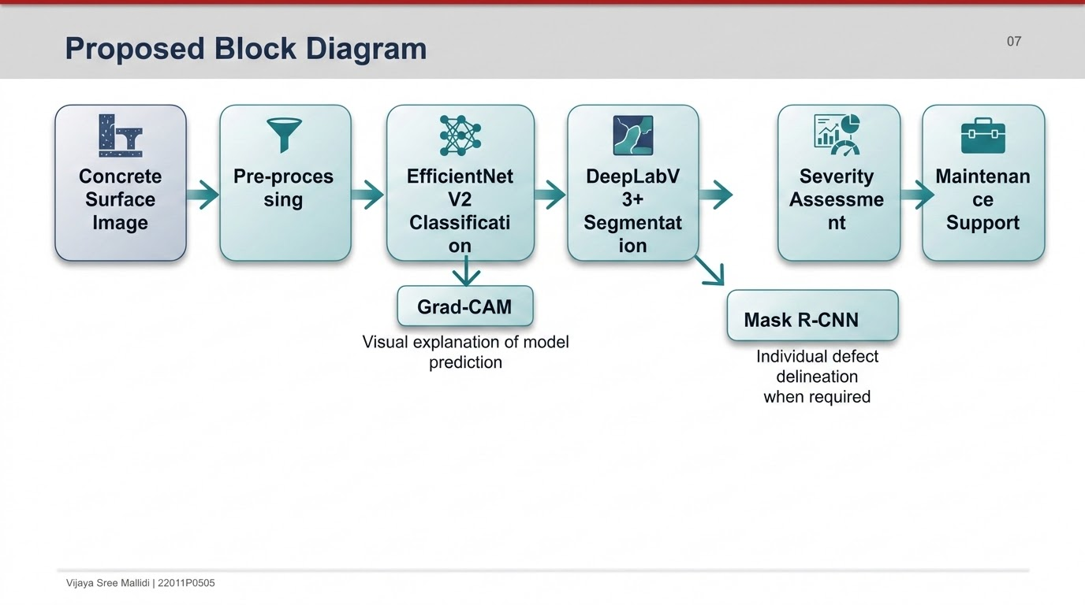

Slide 7
Implementation Plan
08
Dataset preparation: collect/organize concrete surface images and prepare labels for the target defect categories.
Pre-processing: resize and normalize images and prepare suitable inputs for classification and segmentation.
Classification: train EfficientNetV2 to learn features and classify cracks, peeling, scaling, spalling, corrosion stains, and exposed reinforcement.
Localization: train DeepLabV3+ to obtain pixel-level damaged regions; use Mask R-CNN for individual object delineation where required.
Explainability: apply Grad-CAM to visualize image regions influencing classification decisions.
Severity and output: derive severity information from segmented defect characteristics and present results for maintenance support.

Slide 8
Conclusion
09
The proposed framework addresses automated analysis of multiple concrete surface defects.
EfficientNetV2 is used for classification, while DeepLabV3+ and Mask R-CNN address precise localization requirements.
Grad-CAM adds visual interpretability to the deep-learning predictions.
Severity assessment based on segmented defect characteristics connects image analysis with maintenance support.
The overall approach aims to provide accurate, localized, explainable, and useful concrete defect inspection.

Slide 9
References
10
[1] D. Alvani, G. Akbarizadeh, K. Gheisari, and A. Kosarian, “Corrosion detection, localization, and severity estimation on gas pipeline surfaces using transfer learning and image processing,” Array, vol. 29, Art. no. 100698, Mar. 2026, doi: 10.1016/j.array.2026.100698.
[2] M. Tan and Q. V. Le, “EfficientNetV2: Smaller models and faster training,” in Proc. 38th Int. Conf. Machine Learning (ICML), vol. 139, 2021, pp. 10096–10106.
[3] L.-C. Chen, Y. Zhu, G. Papandreou, F. Schroff, and H. Adam, “Encoder-decoder with atrous separable convolution for semantic image segmentation,” in Proc. Eur. Conf. Computer Vision (ECCV), 2018.
[4] K. He, G. Gkioxari, P. Dollár, and R. Girshick, “Mask R-CNN,” in Proc. IEEE Int. Conf. Computer Vision (ICCV), 2017, pp. 2961–2969.
[5] R. R. Selvaraju, M. Cogswell, A. Das, R. Vedantam, D. Parikh, and D. Batra, “Grad-CAM: Visual explanations from deep networks via gradient-based localization,” in Proc. IEEE Int. Conf. Computer Vision (ICCV), 2017, pp. 618–626, doi: 10.1109/ICCV.2017.74.

Slide 10
THANK YOU

